Slide 1

JASTER Instruction (Jason Altimetry Stand-Alone Tool for Enhanced Research)
Amirhossein Rostami, Natalya Maslennikova, Hyongki Lee
Department of Civil and Environmental Engineering
University of Houston

Slide 2
Outline
Python setup
Some preparations before running JASTER
Run JASTER
Example results

Slide 3
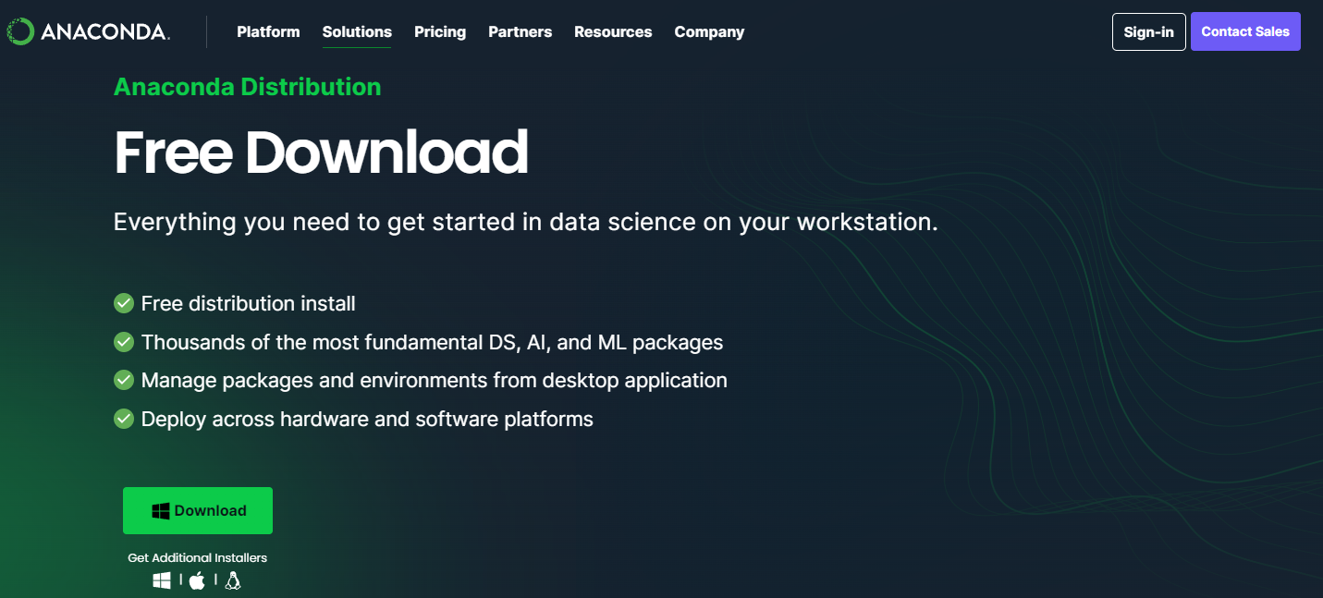
Python Setup 1. Install Anaconda
Anaconda
Create virtual environment for better management of python packages
Download and install
Link: https://www.anaconda.com/download

Slide 4
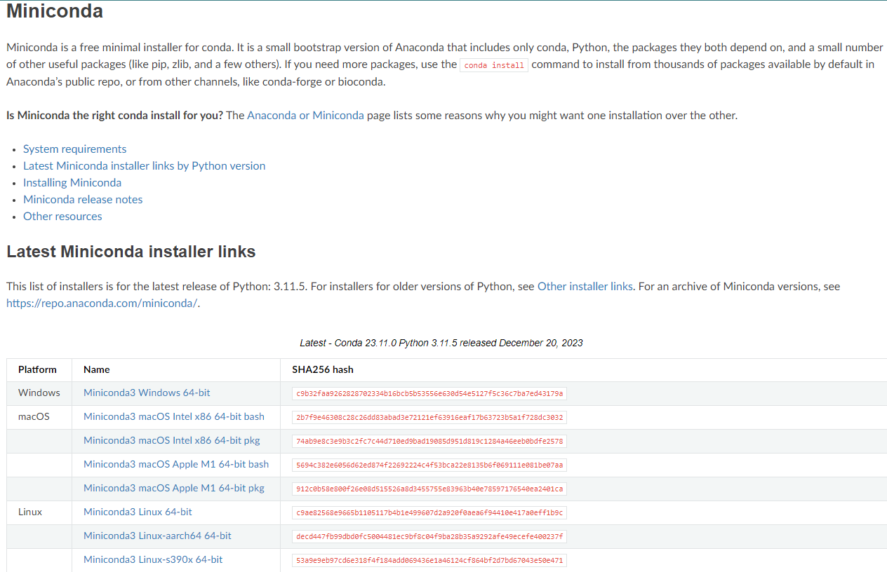
Python Setup 1. Install Anaconda
Miniconda
If you do not have anaconda installed, we recommend using Miniconda,
Download and install
Link: https://docs.conda.io/projects/miniconda/en/latest/

Slide 5
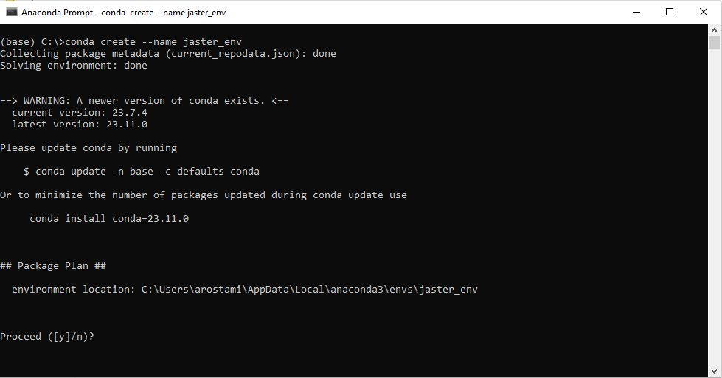
Python Setup 2. Create a virtual environment
Run “Anaconda Prompt” in Windows or open the terminal (on macOS or Linux)
In “Anaconda Prompt,” enter:
conda create --name NAME_OF_ENVIRONMENT (we suggest naming it jaster_env for convenience)

Slide 6
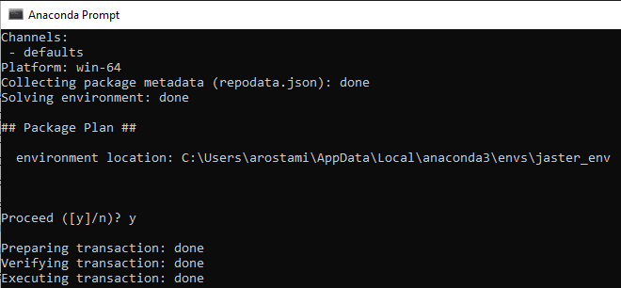
Python Setup 2. Create a virtual environment
Run “Anaconda Prompt” in Windows or open the terminal (on macOS or Linux)
In “Anaconda Prompt,” enter:
conda create --name NAME_OF_ENVIRONMENT (we suggest naming it jaster_env for convenience)
Enter “y” when being asked “Proceed ([y]/n)?”
Wait till installation complete

Slide 7
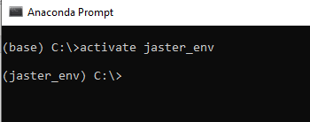
Python Setup 2. Create a virtual environment
Run “Anaconda Prompt”
In “Anaconda Prompt,” enter
conda create --name NAME_OF_ENVIRONMENT (e.g., jaster_env)
Enter “y” when being asked “Proceed ([y]/n)?”
Wait till installation complete
Activate the virtual environment

Slide 8
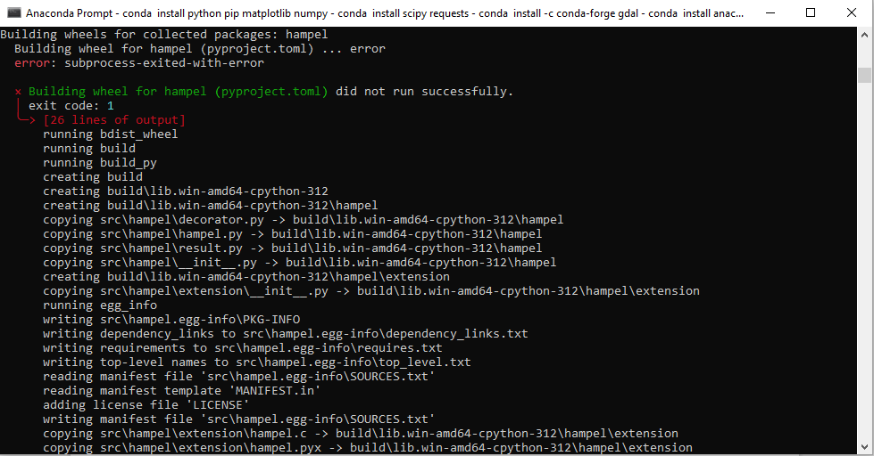
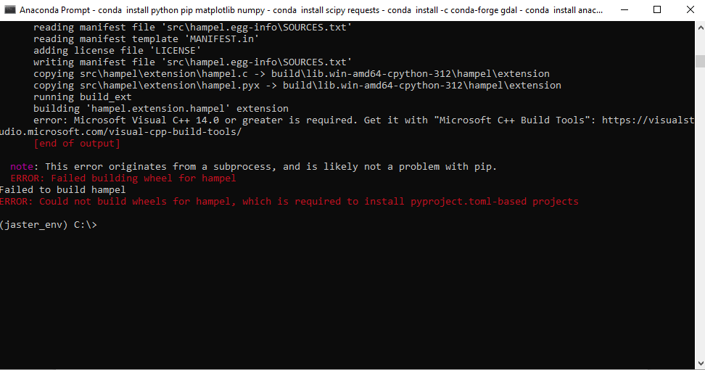
Python Setup 3. Install required packages
Required Python Modules: netcdf4/numpy/matplotlib/scipy/matplotlib/ etc.
Install by typing in (make sure you have activated the virtual environment)
conda install python pip matplotlib numpy scipy requests
conda install -c conda-forge gdal
conda install tkinter (If you get error, then use “conda install anaconda::tk”)
pip install netcdf4 rioxarray rasterio screeninfo
pip install -U scikit-learn
pip install hampel
You may get error while installing hampel package (It is more likely to happen for Windows users)
(1)
(2)

Slide 9

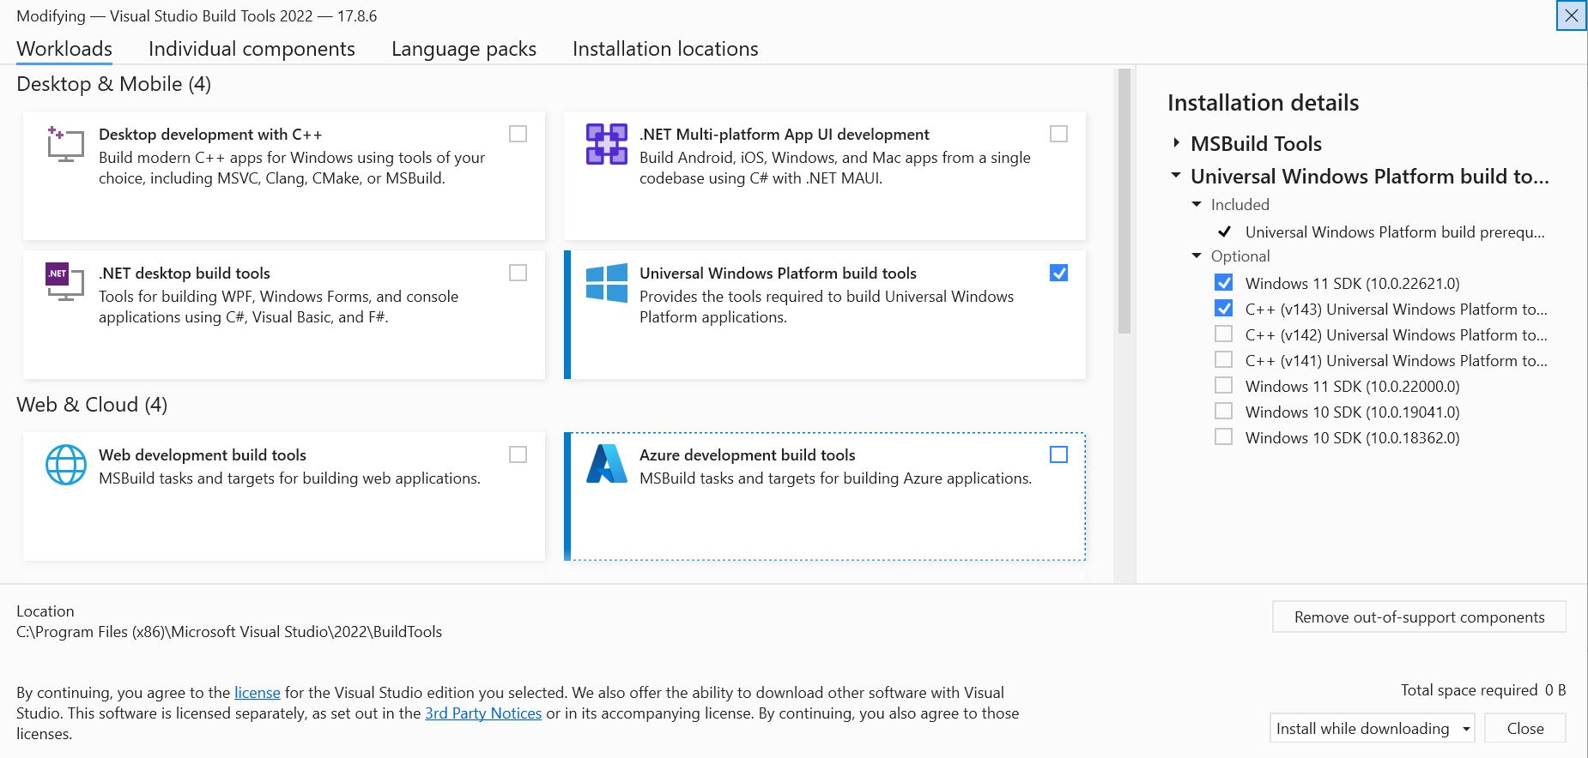
Python Setup 3. Install required packages (Cont.)
In this case, If you don't have the Microsoft Visual C++ 14 version or greater,
go to the (https://visualstudio.microsoft.com/visual-cpp-build-tools/ )
download Microsoft C++ Build Tools.
install Visual Studio (most updated version is preferred) and also Windows SDK (11 or 10 based on user's windows version).

Slide 10
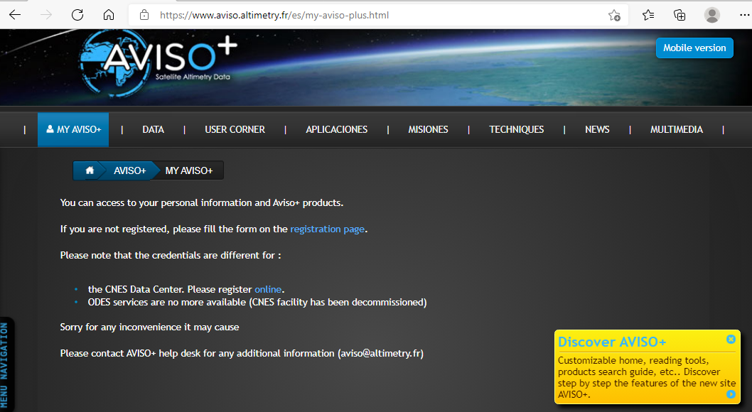
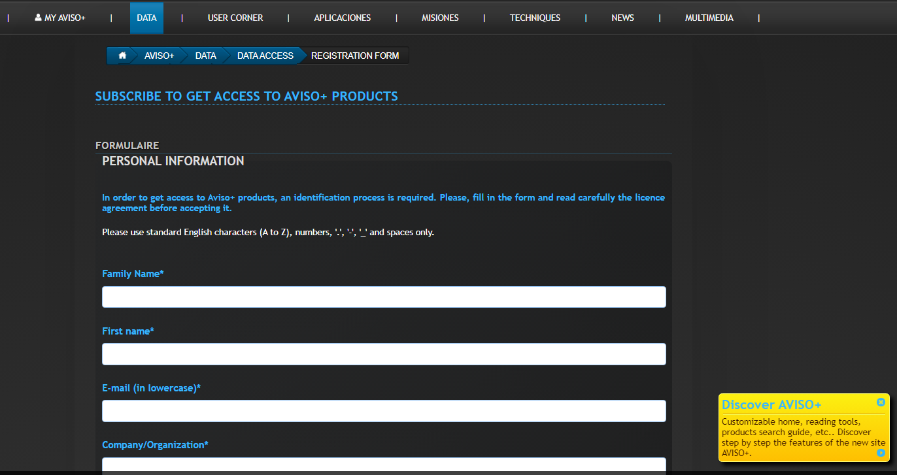
Before Running JASTER
To download Jason series altimetry data:
Create Account via AVISO: https://www.aviso.altimetry.fr/en/my-aviso-plus.html

Slide 11
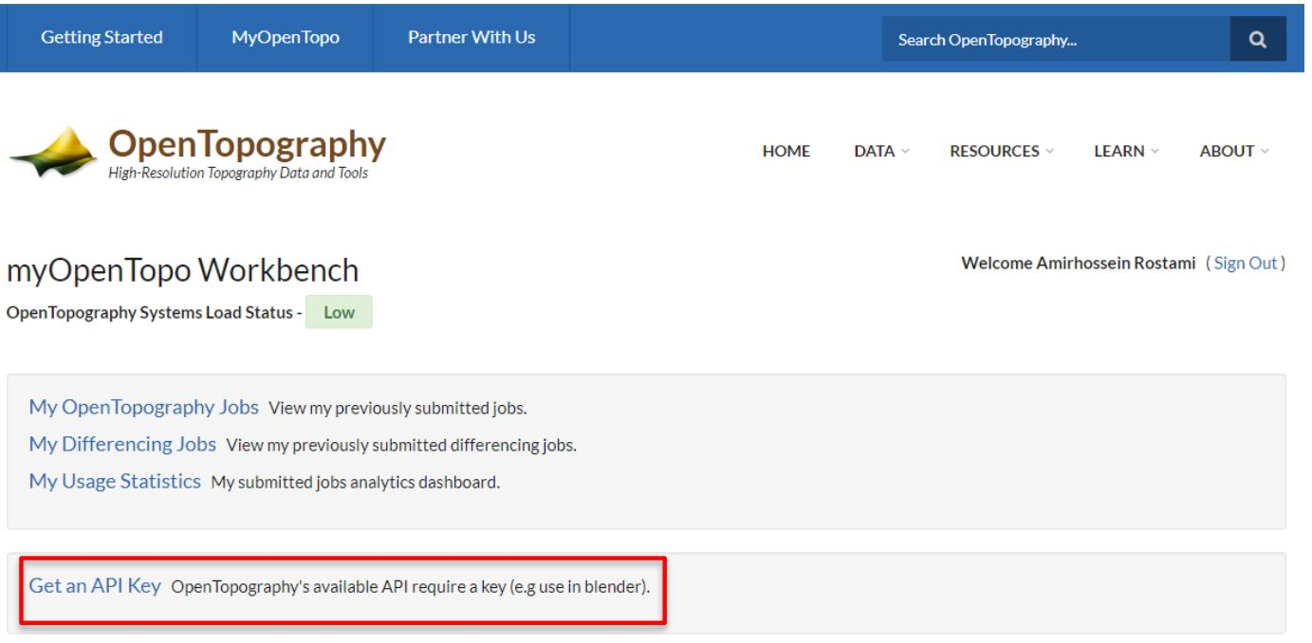
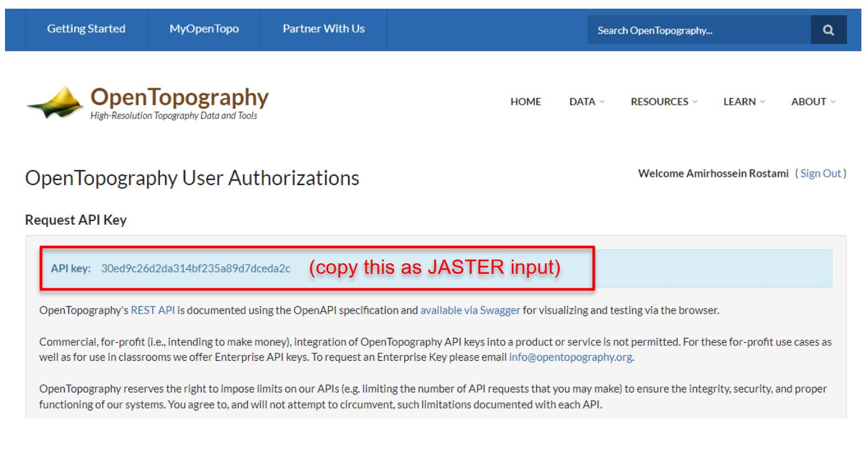
Before Running JASTER
OpenTopography API Key
To achieve the SRTM DEM API Key,
go to the https://portal.opentopography.org/login and create an account if you do not have:

Slide 12
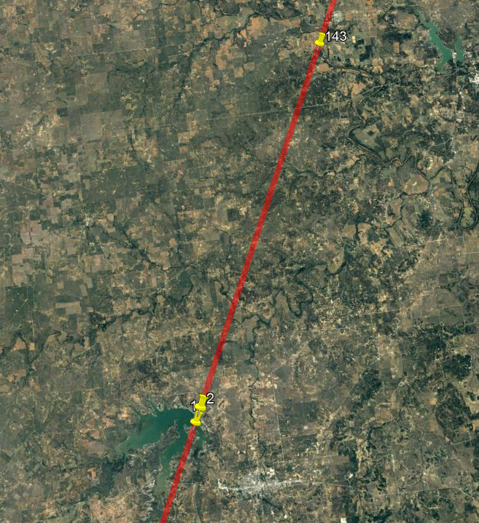
Before Running JASTER
Pass #
Check pass # using Google Earth and Jason ground track (Visu_RefOrbit_J3J2J1TP_Tracks_GoogleEarth_V3.kmz)
Download kmz via: https://www.aviso.altimetry.fr/en/data/tools/pass-locator.html
Latitude Range: 32.811~32.823

Slide 13
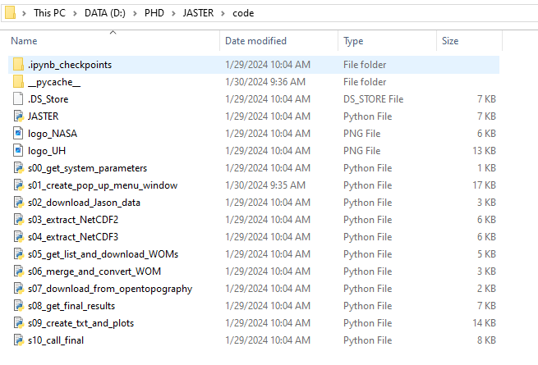
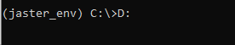
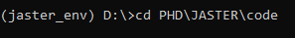
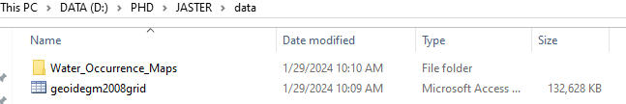
Before Running JASTER
Open Anaconda prompt and change working directory to where the python codes exist:
By default, working directory is in C drive. To switch to other drive:
cd ‘PATH_TO_YOUR_PYTHON_CODE’
‘geoidegm2008grid.mat’ and Water Occurrence maps are required for time series plot.
Then, execute “python JASTER.py” launching JASTER and opens its graphical user interface.

Slide 14
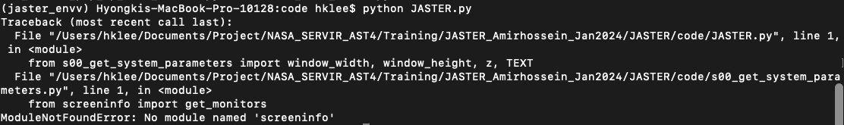
Before Running JASTER
You may encounter some errors before running JASTER such as:
No module named “name of the module” even though you have already installed it. For example:
In this case, reinstall modules which give this error in Anaconda Prompt as we described in slide 8
If it does not work again, reinstall modules through Jupyter Notebook

Slide 15
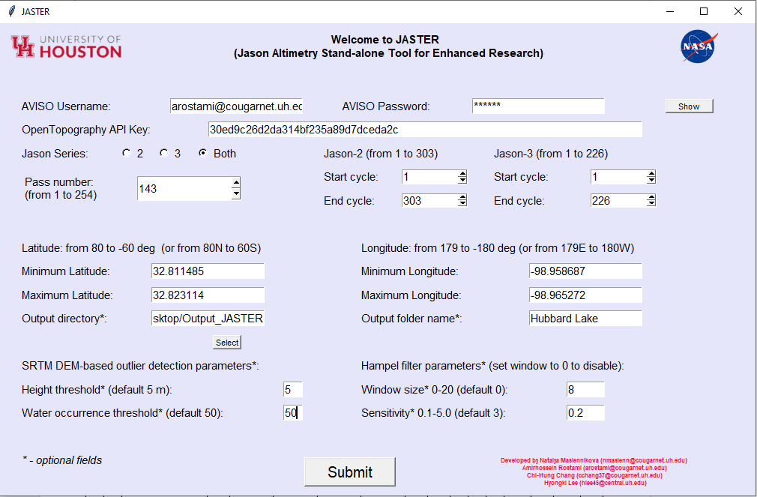
JASTER Inputs
1
Input all required information
AVISO username & Password (slide 10)
API Key to download SRTM DEM from OpenTopography (slide 11)
Jason Series #: select 2 or 3 or both
Pass #: from 1 to 254
Start and end cycle #:
Jason-2: Cycle ranges from 1 (2008/07) to 303 (2016/09)
Jason-3: Cycle ranges from 1 (2016/02) to most recent 226 (2022/03) (Replaced by Sentinel-6 afterward)
Latitude and Longitude range of the reservoir/lake of interest from Google Earth (slide 12)
Height and WO threshold for SRTM DEM-WO deoutlier method
Directory path to save JASTER output results
Hampel filter parameters (W, S). If you don’t want use Hampel, let Window size = 0

Slide 16
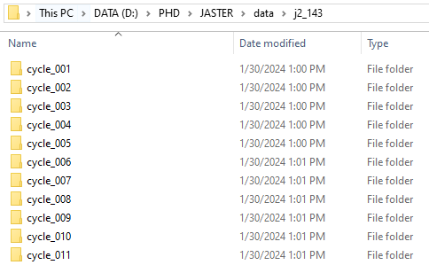
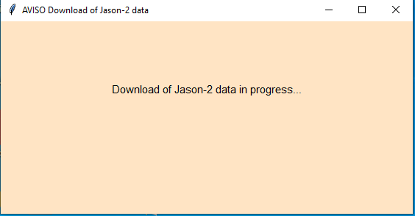
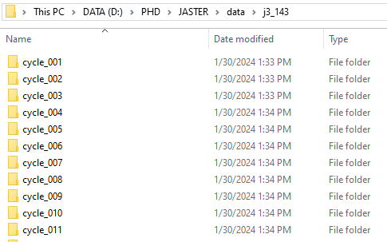
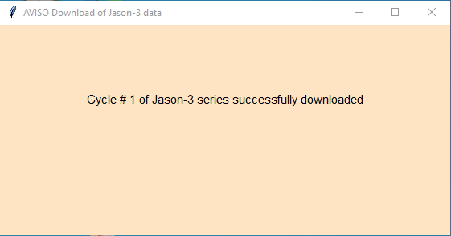
Data Download
2
3
Open “j2_Pass#” or “j3_Pass#” folder after data download complete to confirm the downloaded cycles

Slide 17
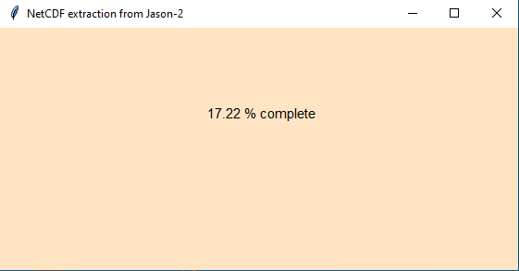
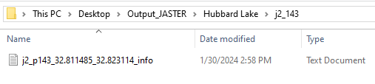
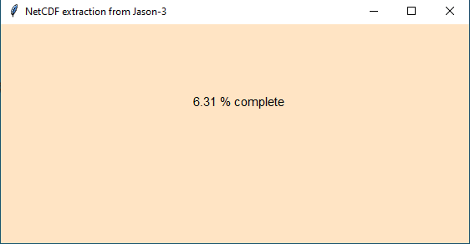
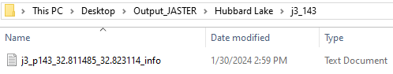
Variable Extraction
Jason-2
4
Extraction Processing
When it becomes completed
Jason-3
5

Slide 18
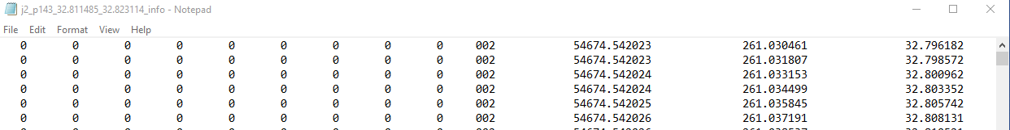
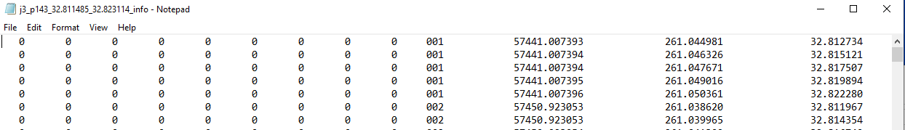
Variable Extraction
Columns:
(10) Jason-2 or 3 Cycle Numbers
(11) Decimal year
(12) Longitude
(13) Latitude
(14) Height (meter w.r.t. EGM2008 Geoid) before applying outlier removal methods
(15) Uncertainty (meter)

Slide 19
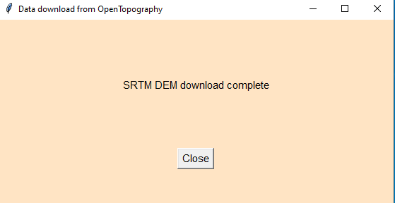
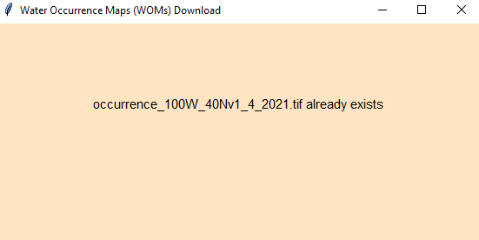
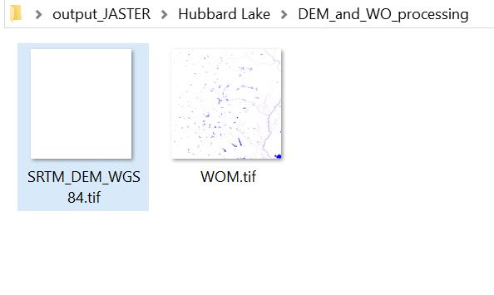
SRTM DEM-Water Occurrence outlier removal
7
6
API key of OpenTopography + (Lat, Long) range.
SRTM DEM will be downloaded automatically.
We have already provided users with WO maps in JASTER data file.
Users can also download it directly from (https://global-surface-water.appspot.com/download )
WO map and SRTM DEM are cropped based on Lat and Long range that user defined for the area of interest.

Slide 20
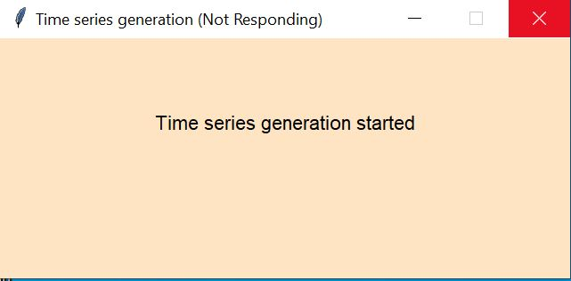
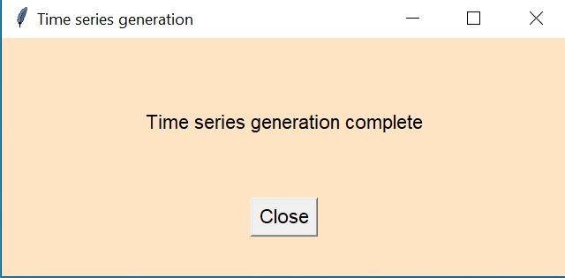
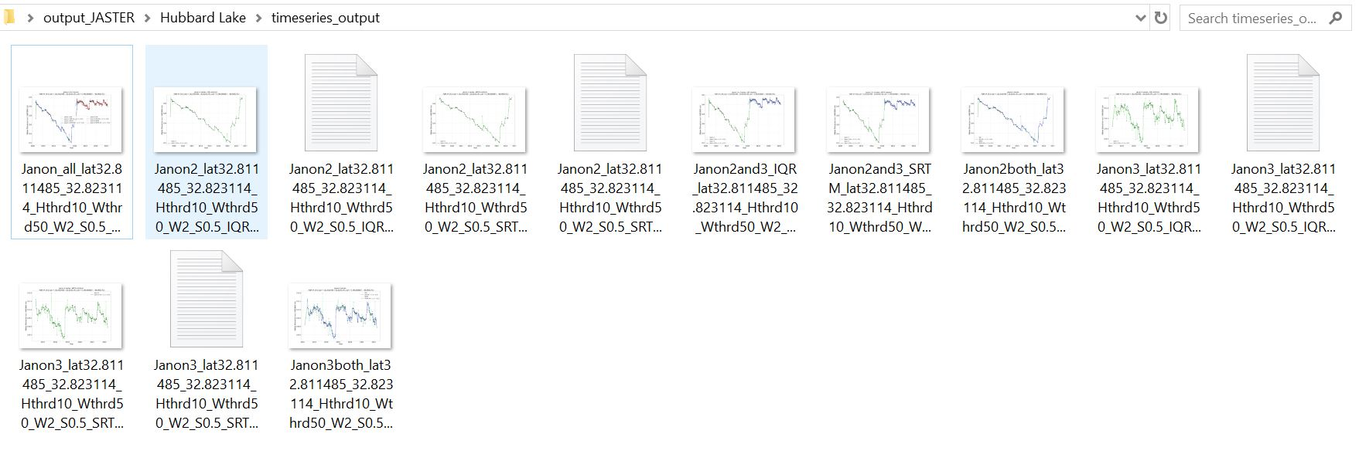
Time Series Plot (Final Outputs)
8
9
These are all JASTER output files with corresponding time series plots:
Jason-2 IQR
Jason-2 SRTM DEM-WO
Jason-3 IQR
Jason-3 SRTM DEM-WO

Slide 21
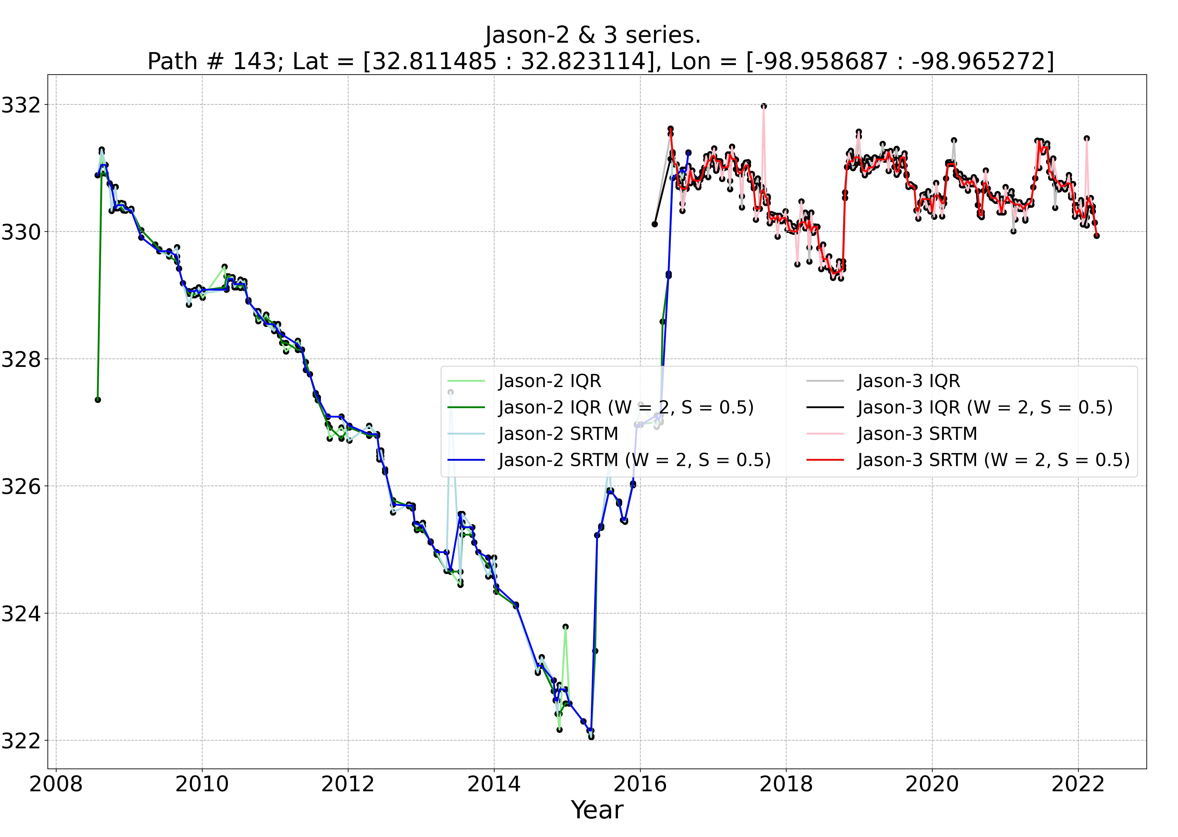
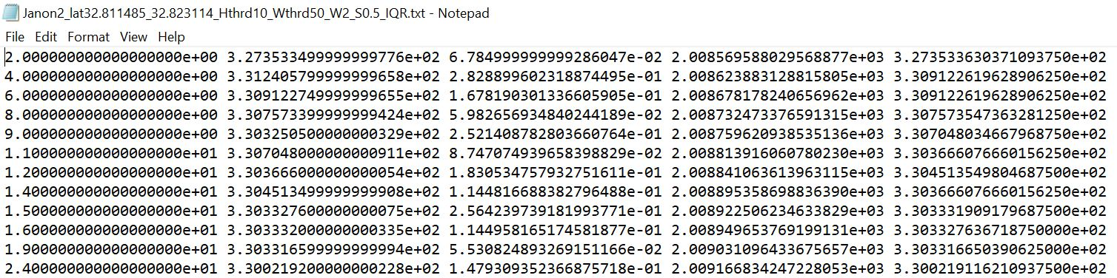
Time Series Plot (Example: Hubbard Creek Lake, TX)
Columns:
(1) Jason-2 (or 3) Cycle Numbers
(2) Water Height (meter w.r.t. EGM2008 Geoid) without Hampel filter
(3) Uncertainty (meter)
(4) Decimal year
(5) Water Height (meter w.r.t. EGM2008 Geoid) with Hampel filter
Water elevation w.r.t EGM08 Geoid
All JASTER output results for Hubbard Creek Lake including: Jason-2 and 3, IQR and SRTM DEM-WO, enabled and disabled Hampel filter.

Slide 22
Acknowledgment
NASA’s Water Resources Program (80NSSC22K0918)
SERVIR Program (80NSSC23K0184).
Contact: Hyongki Lee at hlee45@central.uh.edu

